Slide 1

APPLIED PHYSICS Applications Of Lasers
Prepaid By:-
Name:-S.Goavrdhann
RollNo:-218T1A05B5
Branch:-CSE-B

Slide 2

DEFINITION:-
In my opinion, the laser technology comes from focusing photons of lights on a single spot and such approach makes it more powerful than a beam of light. In addition, I heard many times that it is dangerous to point out a laser dot in someone’s eye.
Furthermore, as we learned about LEDs and that recently blue LED got invented, now that I think about it, I assume I have never seen a blue laser, although I’ve seen red laser and in few cases green laser. Therefore, I assume lasers and LEDs must have a very similar structure for that reason. (additional question: why blue laser was the last one to be invented, if it got invented, and is it similar to LED concept and reason?) I also assume practically it is harder to create green laser comparing to red ones, since, red light laser devices are much more and cheaper comparing to green ones. (additional question: why is it more difficult and more expensive to create green laser comparing to red ones?)

Slide 3

APPLICATIONS:-
Laser technology must have a various application fields, in almost any of the science field you may observe laser technology applications and devices. In the following I mention the applications of such technology as far as I encountered, observed, used, or read about:
Computer devices such as laser mouse, laser presentation, CD ROMs and DVD ROMs
Astronomy and communication applications
Medicine, surgery, and health
War machines, guns and tanks
Cutting matters in metallurgy industry and related industries

Slide 4

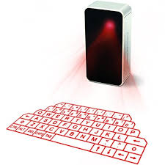
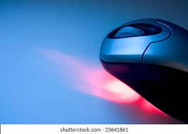
Computer devices:-
In computer industry there are several devices which I encountered that they were using laser technology to function. The reason for selecting such technology were three main reasons. First, the reason was to show a laser light and show a certain spot in places, such as presentations. Second, the reason was to use this technology as a method to navigate through surfaces to understand movement, for instance, laser mouses. Third, the reason was to emit a laser light and by receiving that certain laser understand the data, for instance CD ROMs and DVD ROMs that they emit a laser beam and it hit the surface of a CD or a DVD then it reflects to a receiver looking like an eye and it determines if the data was 0 or 1

Slide 5
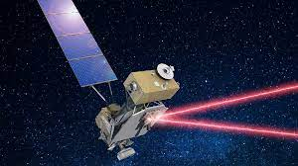
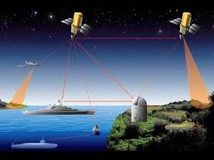
Astronomy and communication applications:-
In astronomy field, I’ve seen a documentary that briefly described the application of communicating satellites with each other using lasers. My assumptions is that they use binary to communicate with each other. By sending bits of data for instance 0 and 1.

Slide 6

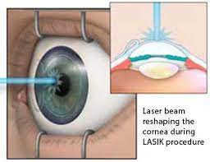
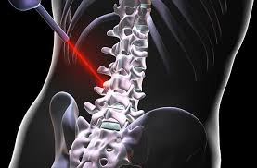
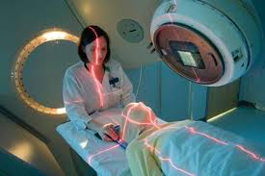
Medicine, surgery, and health:-
In health related topics, lasers had great impact. By using lasers scientists and doctors are able to point out to cancer cells to destroy them and sometimes they do not need to cut the patient's body in order to apply their surgery in cases that cutting may create other disease and in some parts may not even be possible.

Slide 7

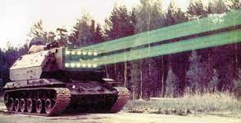
War machines, guns and tanks:-
There are guns that by using laser beams it will fully show the place of bullet in the target’s object. And laser more heavy machinery may use laser as a weapon to create a devastatingly strong armor.

Slide 8
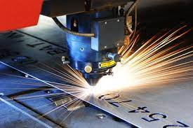
Metallurgy industry:-
To shape, and cut strong matters sometimes in related fields they use laser.

Slide 9

THANKYOU

